Slide 1



GEG MIS PORTAL
User Guide
SEPTEMBER, 2024

Slide 2
GEG MIS
DEMO

Slide 3

Home Page – Login as Program Officer

Slide 4
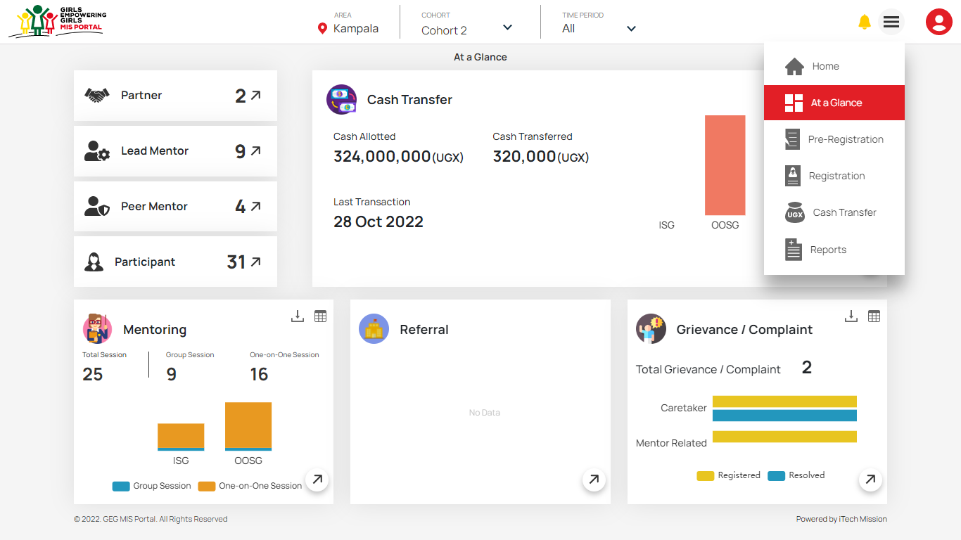
At a Glance – Navigate to Pre-Registration

Slide 5
Pre-Registration

Slide 6
Pre-Registration – View Pre-Registered List

Slide 7
Pre-Registration – Add

Slide 8
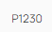
Pre-Registration – Enable/Disable, Edit and Delete

Slide 9
Registration Program Officer

Slide 10
Registration – View Pending Participant List

Slide 11
Registration – Add Participant – Search

Slide 12
Registration – Add Participant – Fill Details

Slide 13
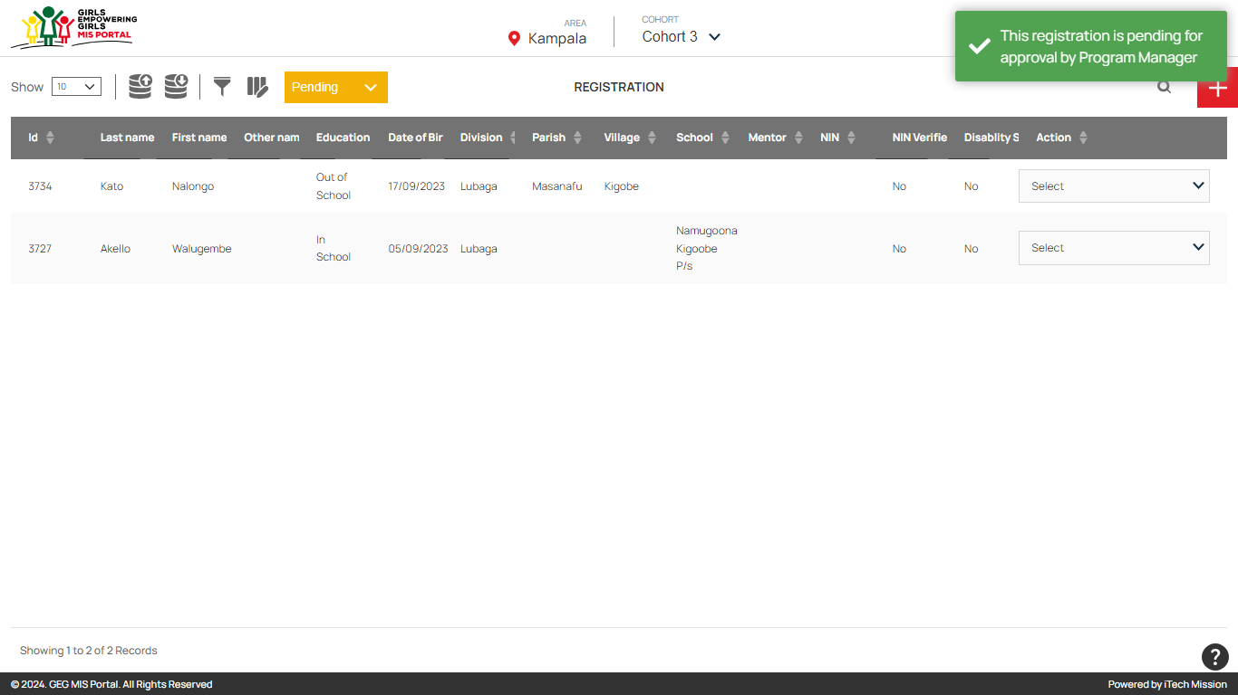
Registration – Participant Registration pending for Approval

Slide 14
Registration Approval Program Manager

Slide 15
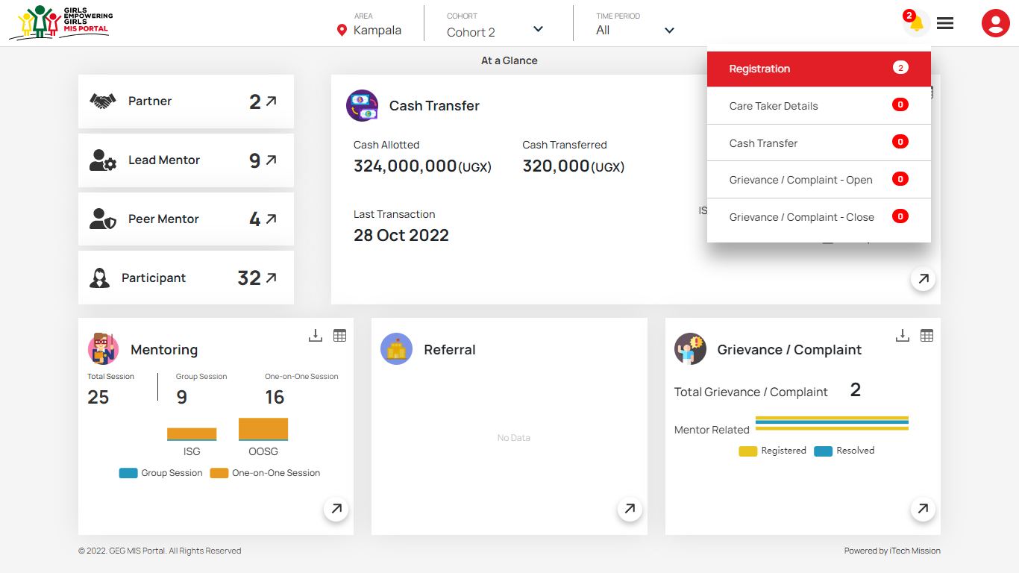
At a Glance – View Notifications – Registration

Slide 16
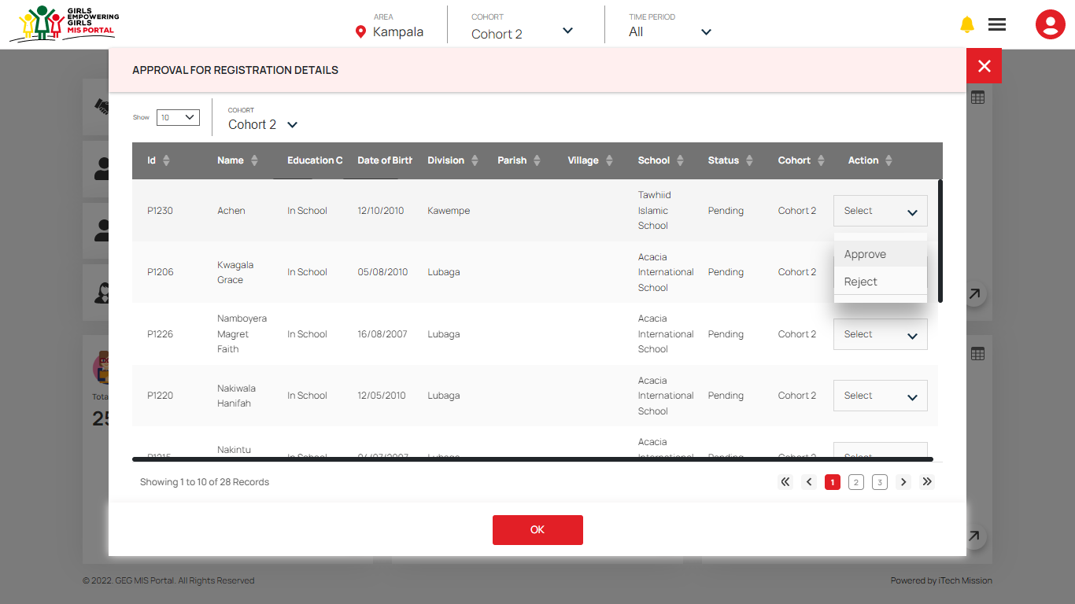
View Notifications – Registration – Approve/Reject

Slide 17
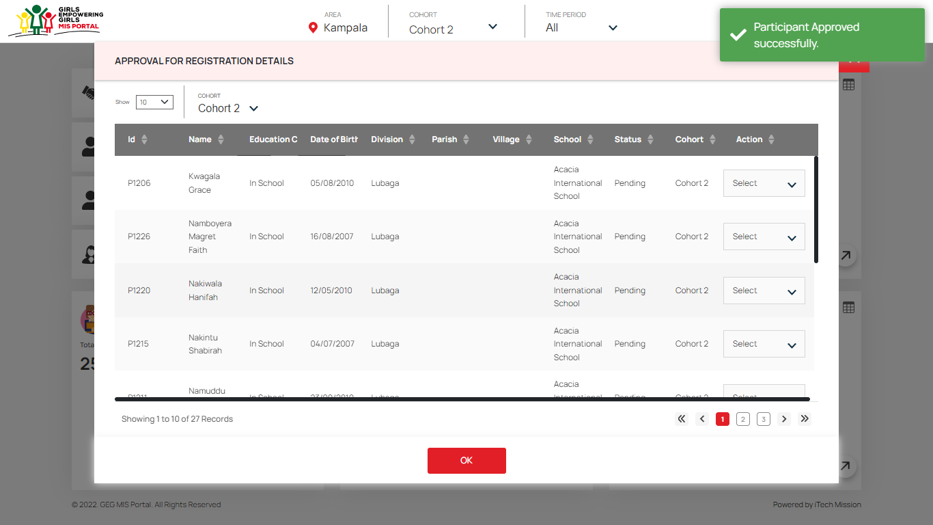
View Notifications – Registration – Approved

Slide 18
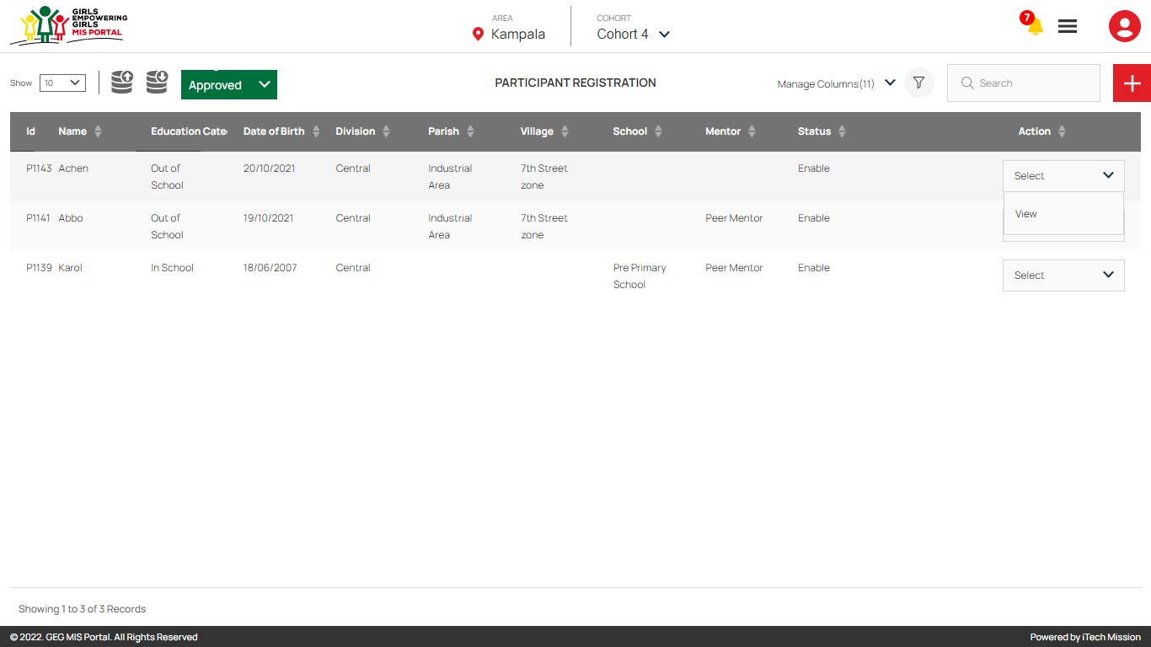
Participant Registration – View Approved Registration

Slide 19
Assign Mentor Program Officer

Slide 20
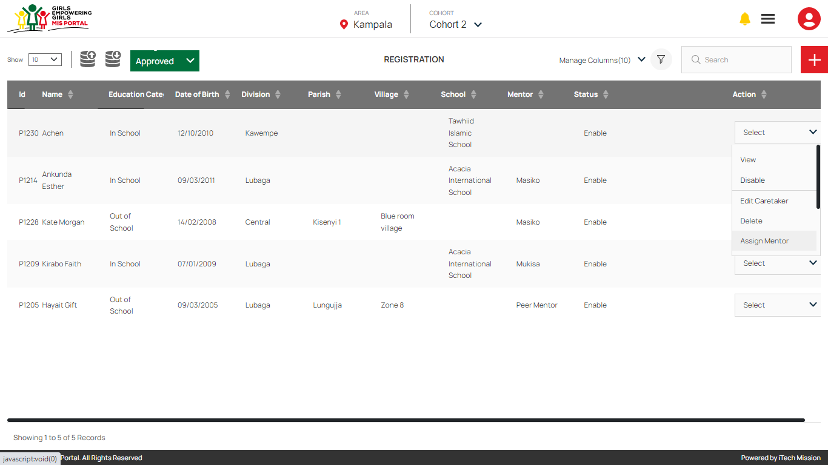
Registration – Approved – Assign Mentor

Slide 21
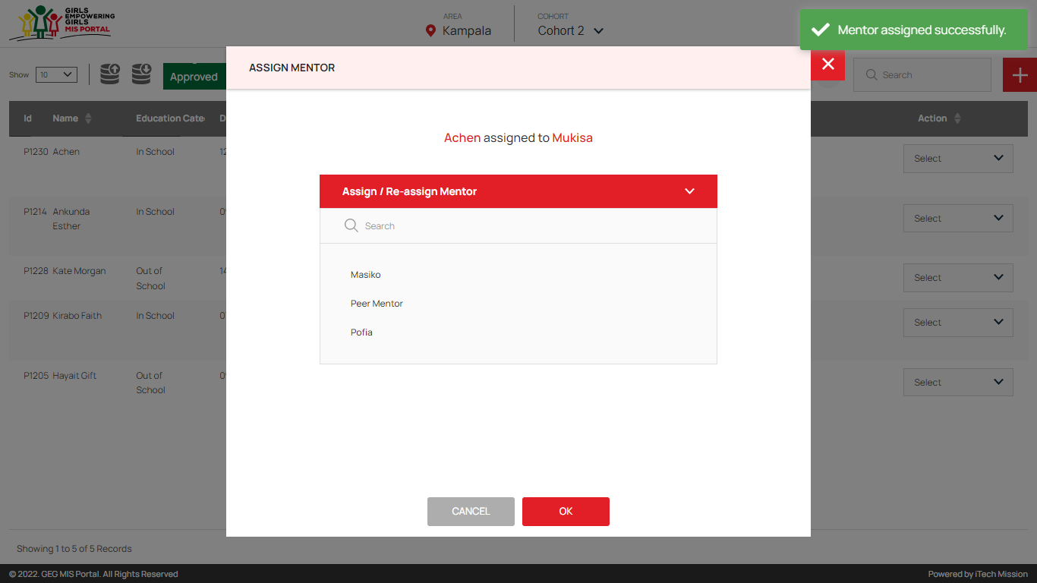
Registration – Assign Mentor

Slide 22
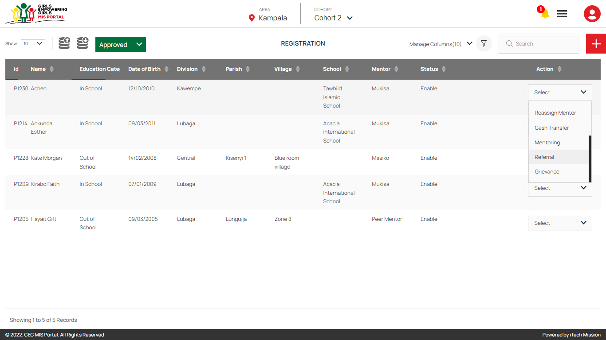
Registration – Reassign Mentor, Cash Transfer, Mentoring, Referral, Grievance

Slide 23
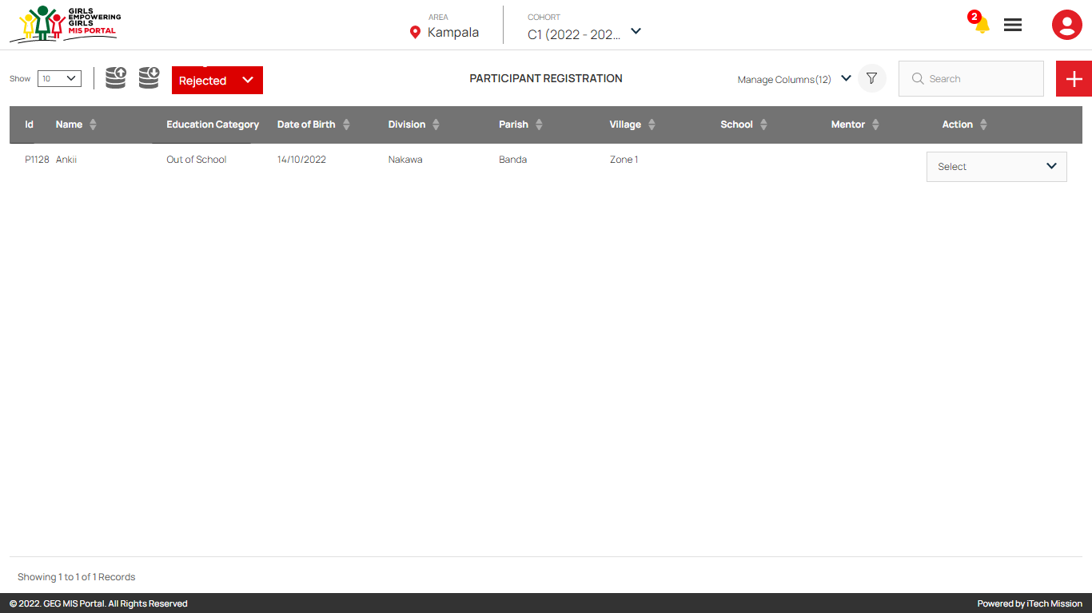
Registration – View Rejected Registrations

Slide 24
Cash Transfer Program Officer

Slide 25
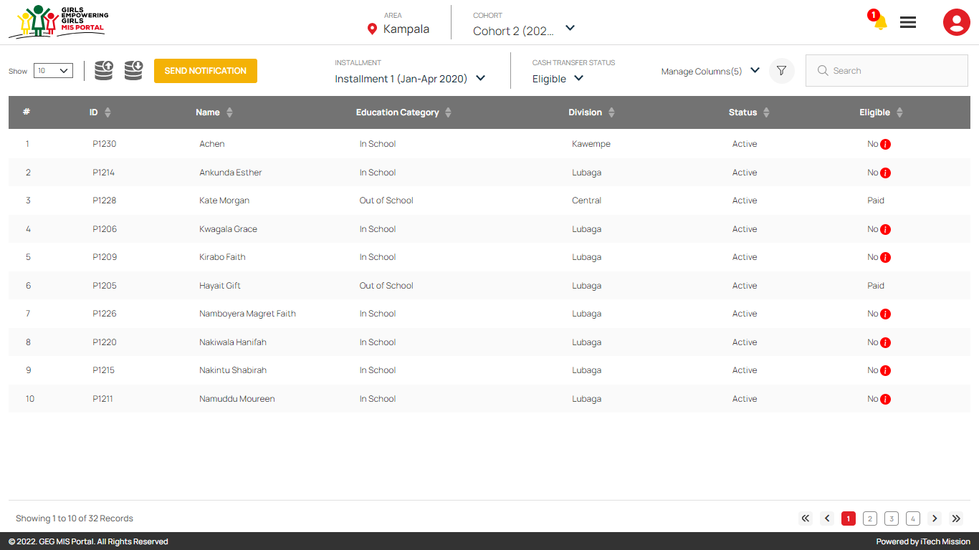
Cash Transfer – Select Cohort, Installment and Cash Transfer Status

Slide 26
Cash Transfer – Export Eligibility List

Slide 27
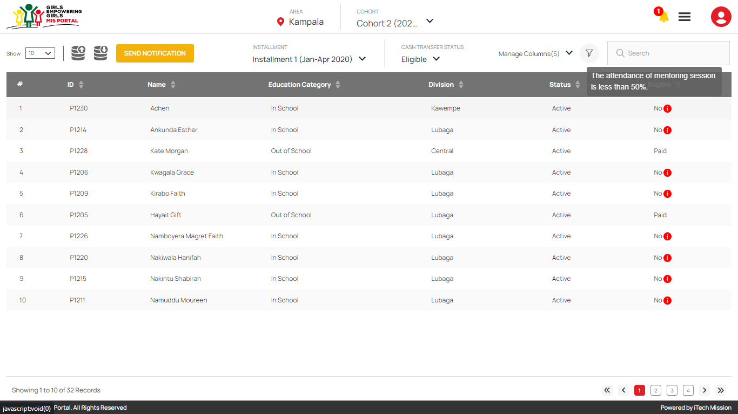
Cash Transfer – View Not Eligible Reason

Slide 28
Mentoring Peer Mentor

Slide 29
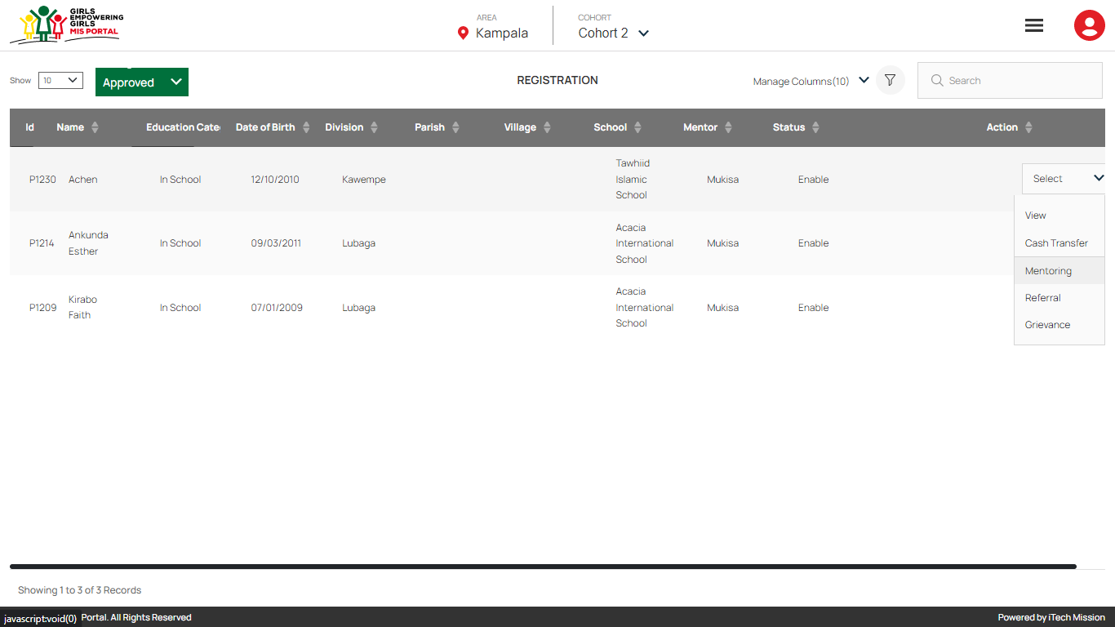
Registration – Mentoring

Slide 30
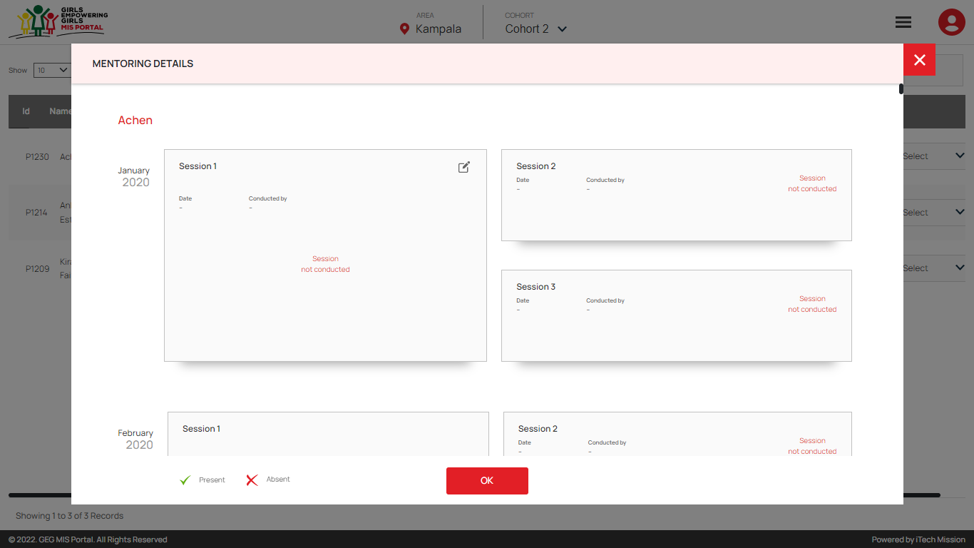
Registration – Mentoring – Edit

Slide 31
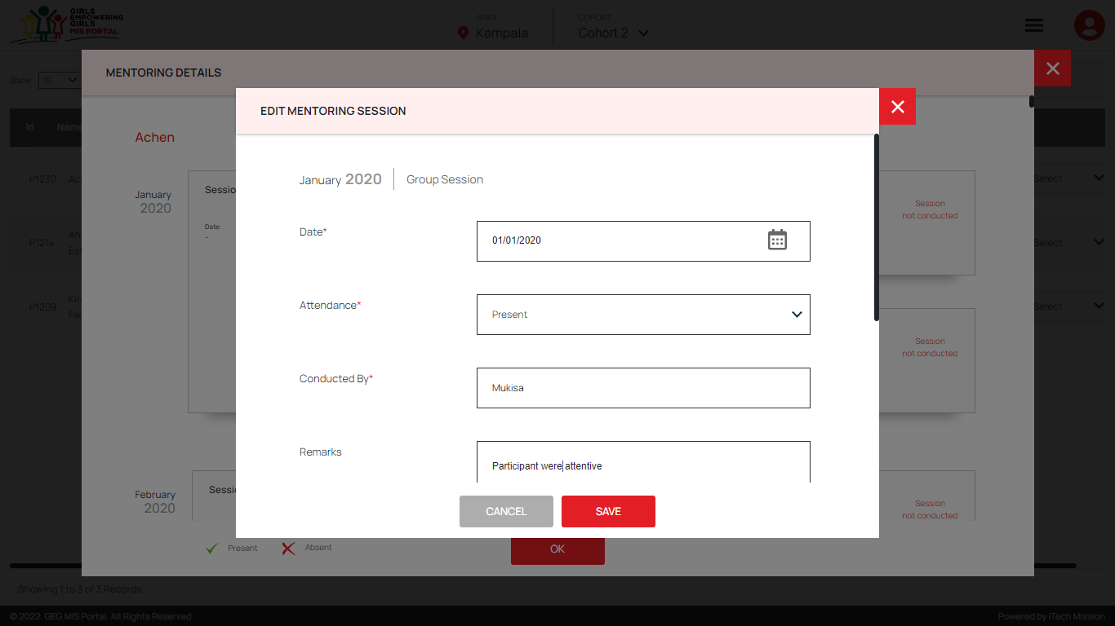
Registration – Mentoring – Edit Group Session

Slide 32
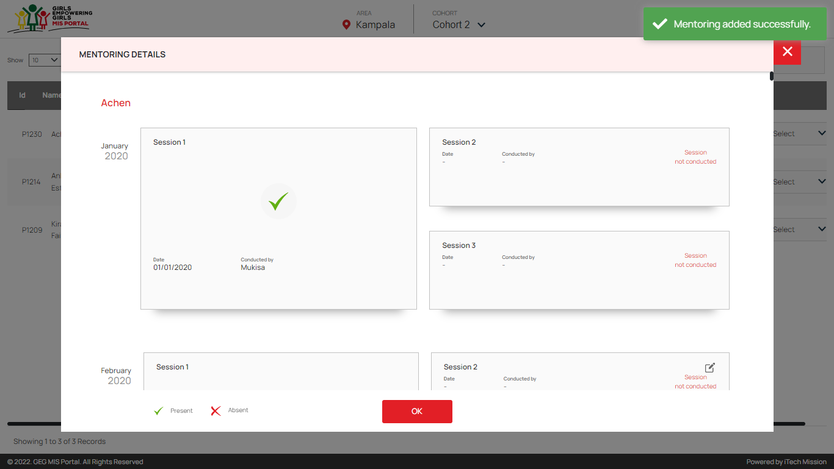
Registration – Mentoring – Group Session Added

Slide 33
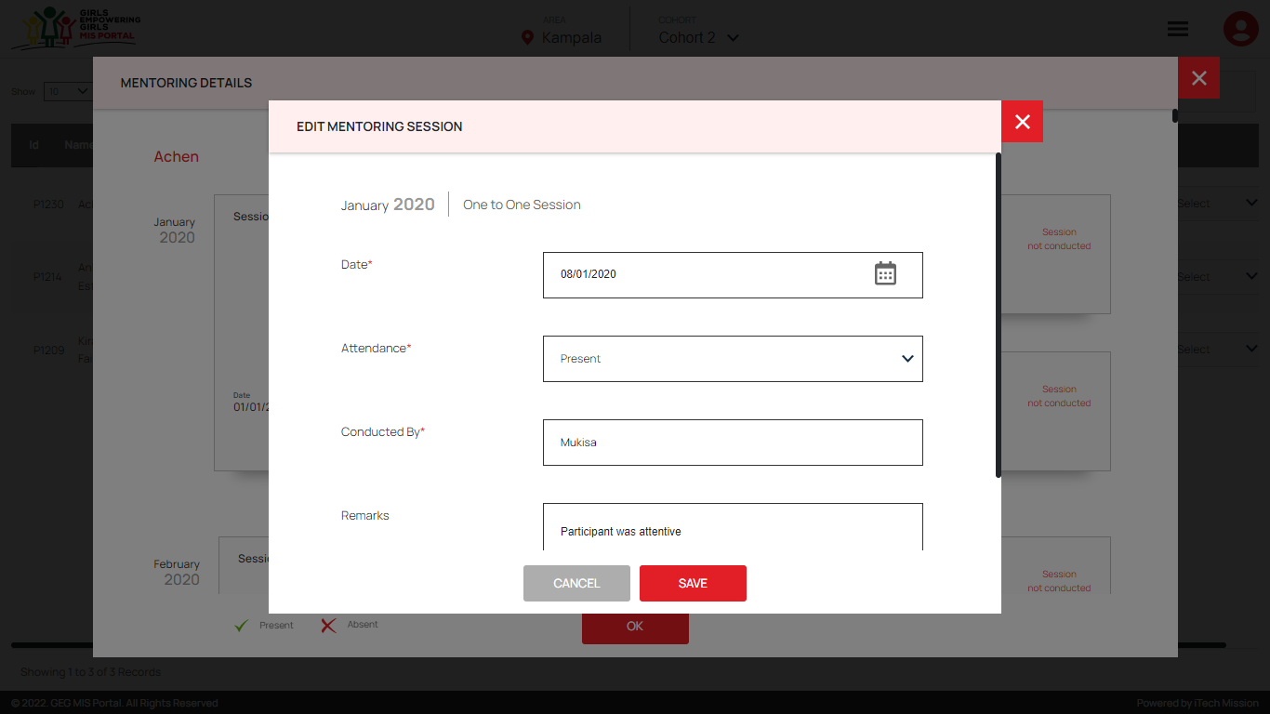
Registration – Mentoring – Edit One to One Session

Slide 34
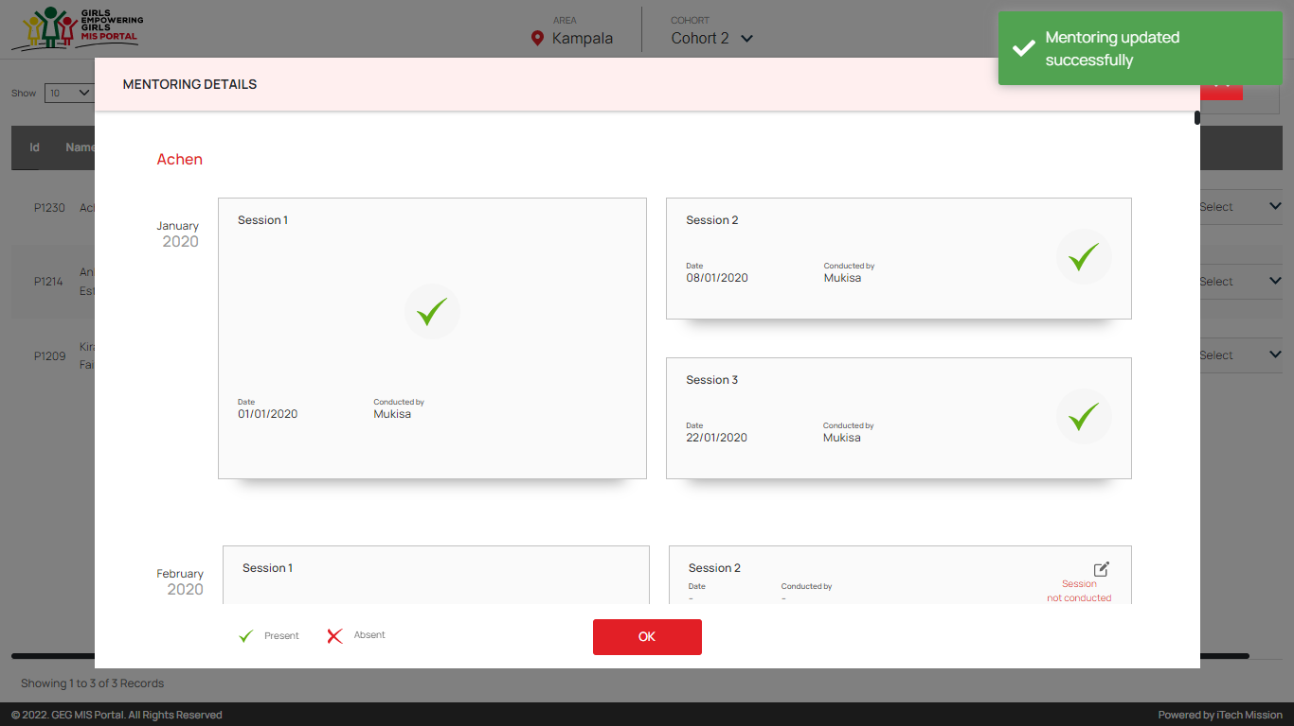
Registration – Mentoring – One to One Session Added

Slide 35
Cash Transfer – First Verification Program Coordinator

Slide 36
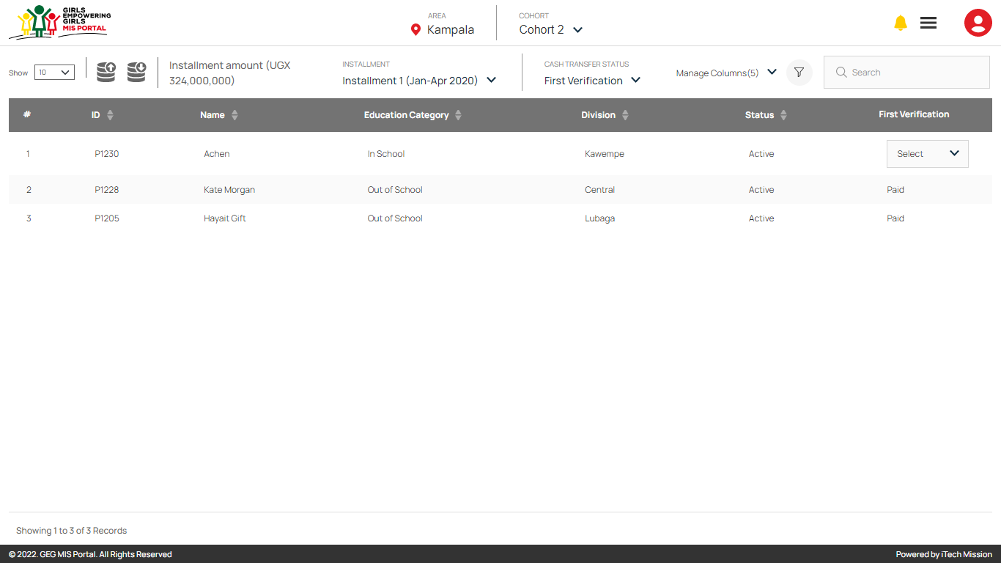
Cash Transfer – First Verification

Slide 37
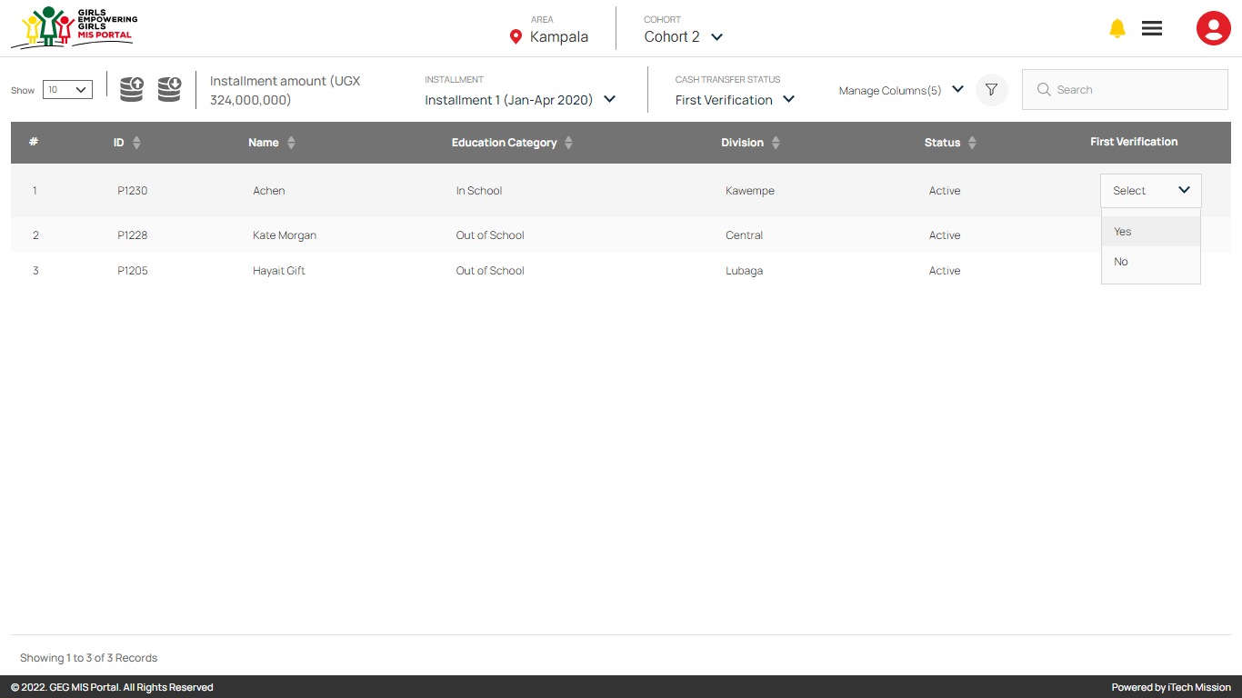
Cash Transfer – First Verification – Yes/No

Slide 38
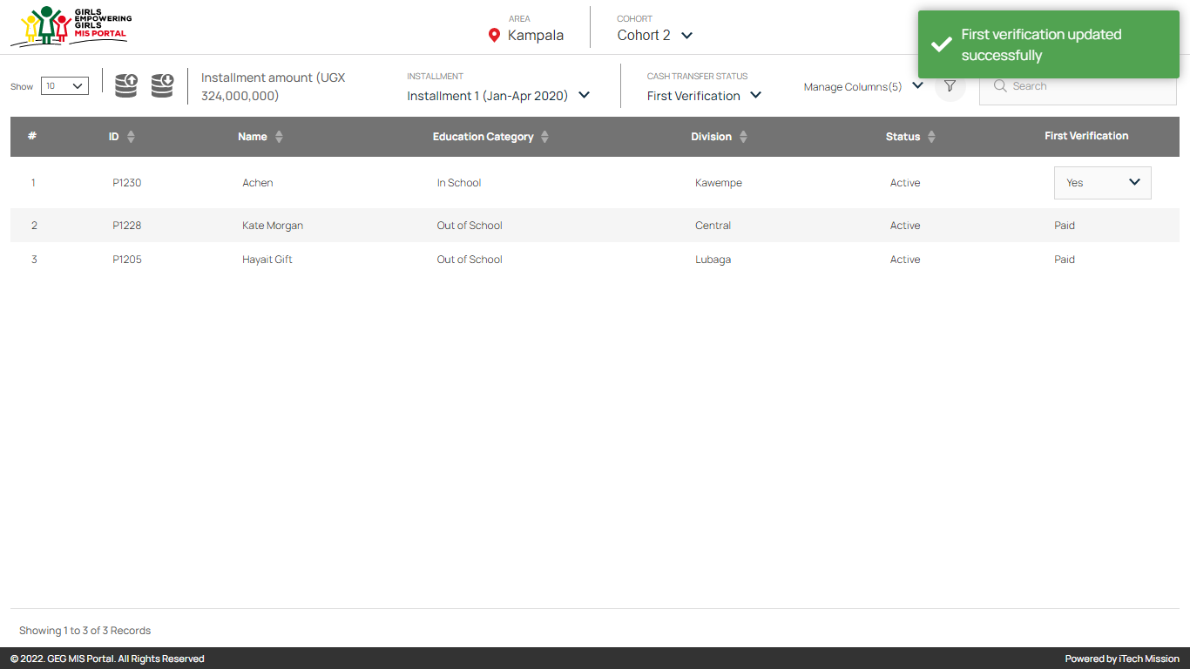
Cash Transfer – First Verification – Verification Completed

Slide 39

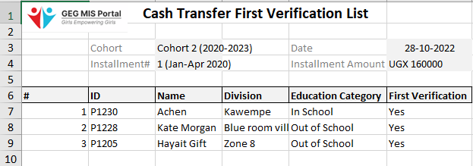

Cash Transfer – First Verification – Export and Import

Slide 40
Cash Transfer – Second Verification Lead Partner

Slide 41
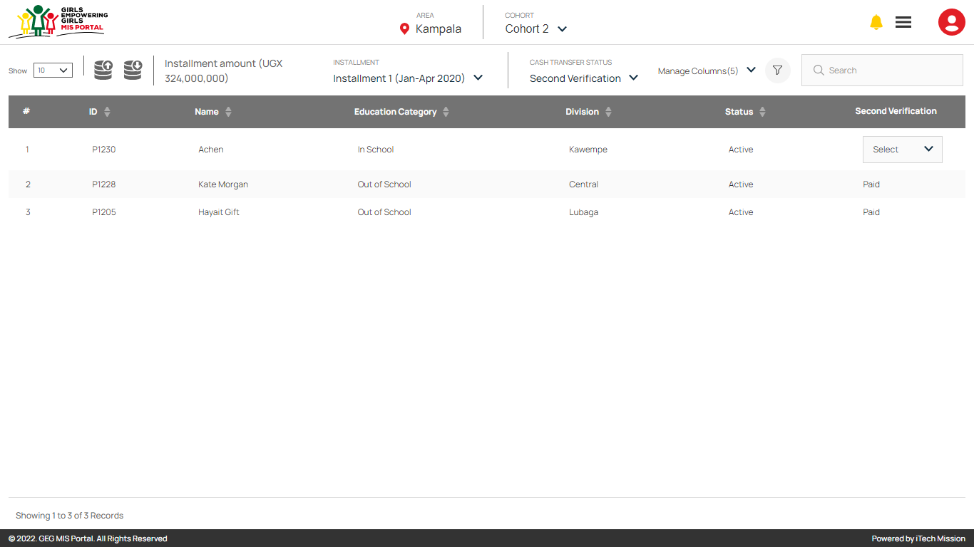
Cash Transfer – Second Verification

Slide 42

Cash Transfer – Second Verification – Yes/No

Slide 43

Cash Transfer – Second Verification – Verification Completed

Slide 44

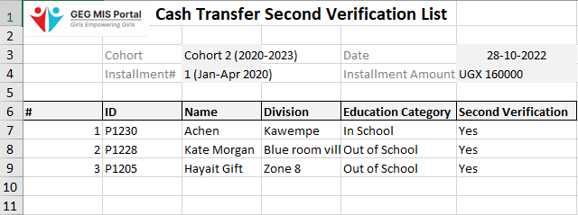
Cash Transfer – Second Verification – Export and Import

Slide 45
Cash Transfer – Approval Program Manager

Slide 46
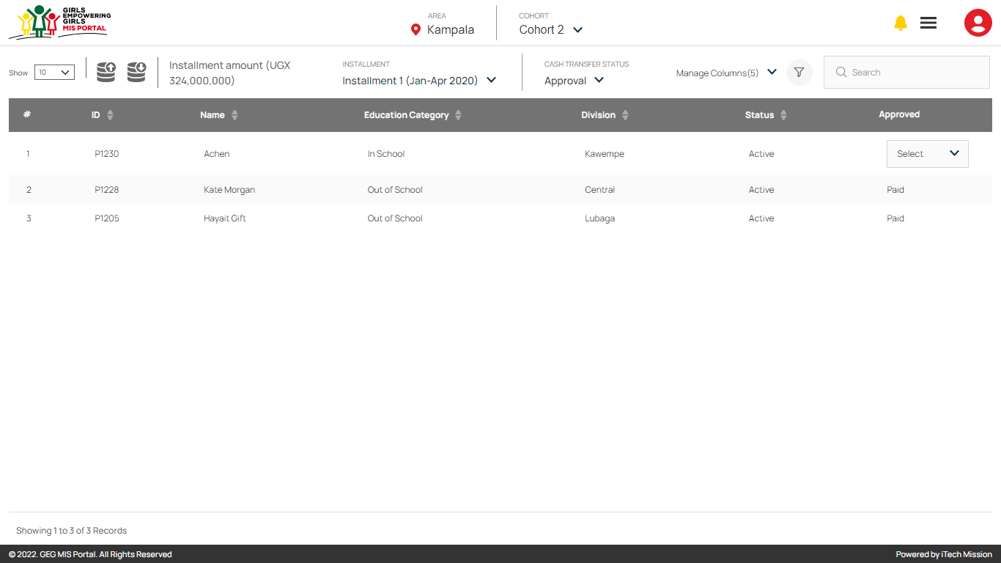
Cash Transfer – Approval

Slide 47

Cash Transfer – Approval – Approved

Slide 48

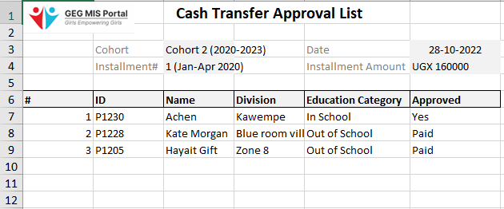
Cash Transfer – Approval – Export and Import

Slide 49
Cash Transfer – Payment Program Officer

Slide 50
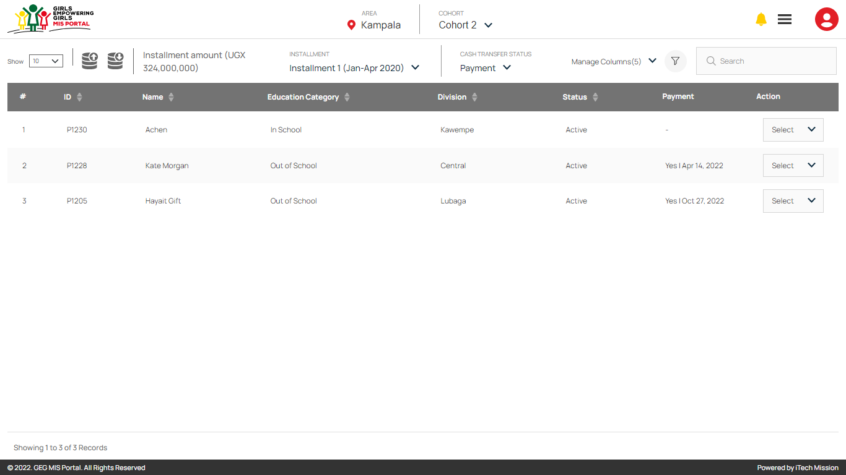
Cash Transfer – Payment

Slide 51

Cash Transfer – Payment – Pay

Slide 52
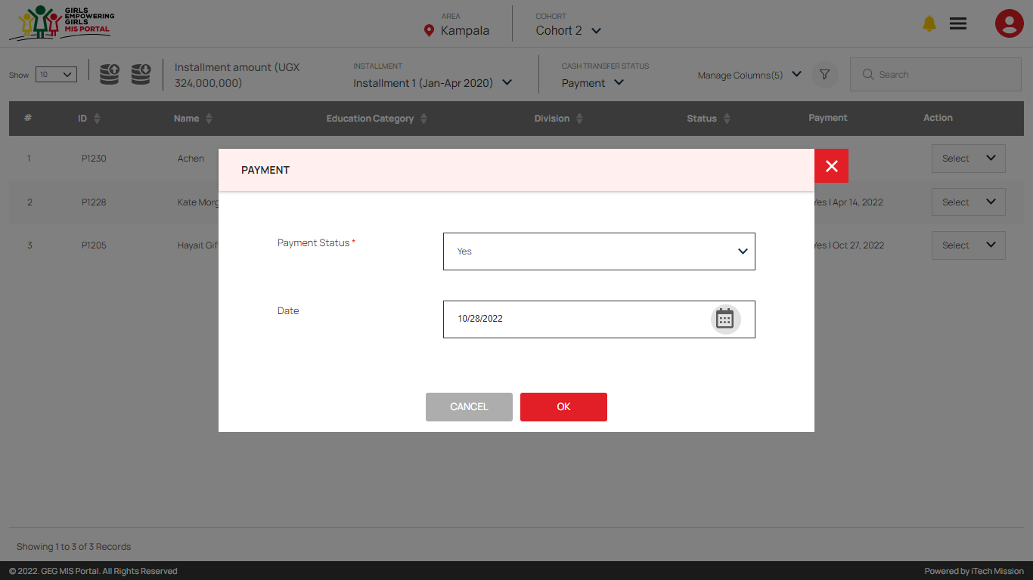
Cash Transfer – Payment – Payment Status and Date

Slide 53
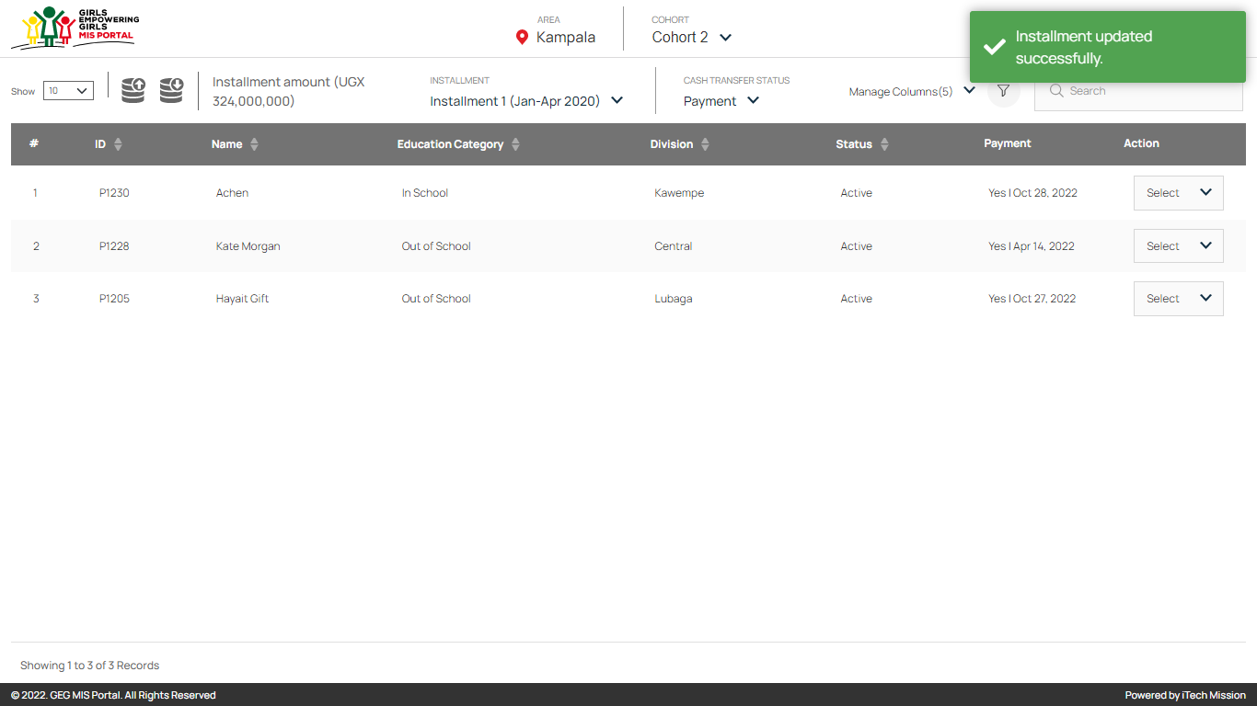
Cash Transfer – Payment – Pay

Slide 54




